Slide 1



Churn Analysis
View in Power BI
Last data refresh:
12/13/2023 4:26:37 AM UTC
Downloaded at:
12/18/2023 11:23:42 PM UTC

Slide 2
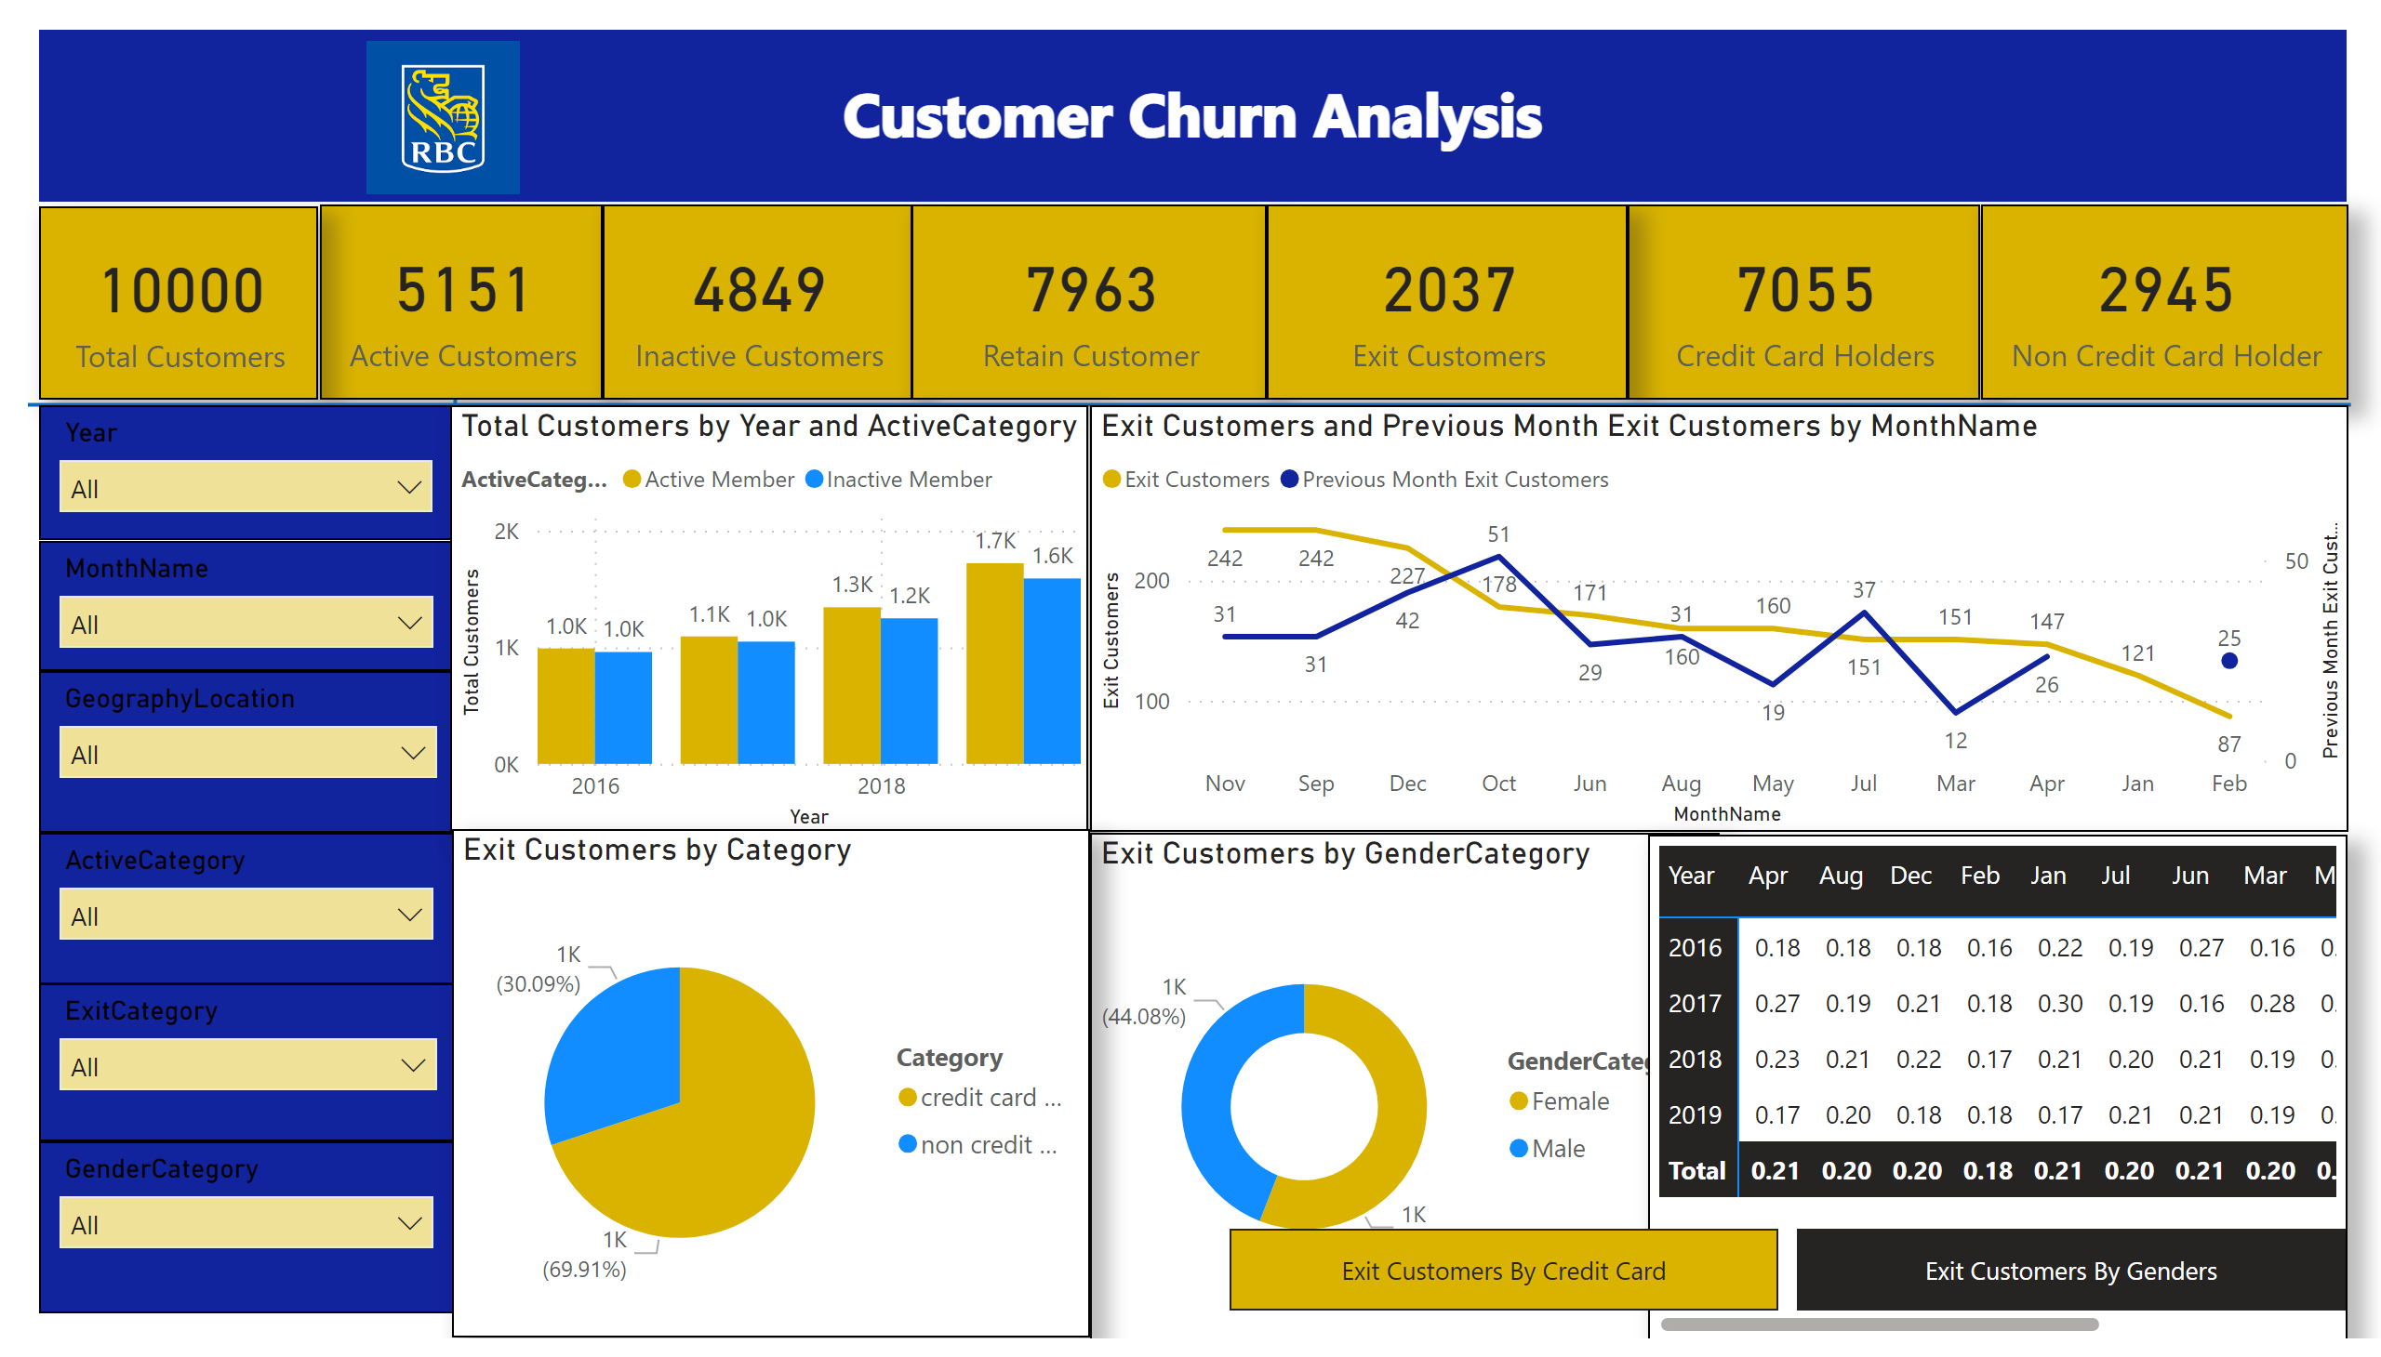
Page 1
Notes:
card
No alt text provided
card
No alt text provided
card
No alt text provided
card
No alt text provided
card
No alt text provided
card
No alt text provided
card
No alt text provided
textbox
No alt text provided
image
No alt text provided
shape
No alt text provided
shape
No alt text provided
slicer
No alt text provided
slicer
No alt text provided
slicer
No alt text provided
slicer
No alt text provided
slicer
No alt text provided
slicer
No alt text provided
clusteredColumnChart
No alt text provided
lineChart
No alt text provided
donutChart
No alt text provided
clusteredBarChart
No alt text provided
pieChart
No alt text provided
pivotTable
No alt text provided
bookmarkNavigator
No alt text provided

Slide 3

Page 2
Notes:
pieChart
No alt text provided

